Slide 1




Session: Introduction To Pair Programming
Presenter: Kevin Jones

Slide 2


Slide 3

Two Heads Are Better
Than One
An Introduction to Pair Programming

Slide 4

Kevin Jones
Senior .NET Consultant
Team Lead
Agile / Lean Evangelist
Microsoft MVP

Slide 5
What Is Pair Programming?
Introduction to Pair Programming

Slide 6
2 developers + 1 computer = ?

Slide 7
Problem Solving
Don’t get lost in the weeds.
Challenge your assumptions.
Take a different approach.
Don’t fear the blank slate.
Ask the teddy bear.

Slide 8
Master and Apprentice
Share your wisdom in context.
Teaching provides a new perspective.
See through fresh eyes.
Let them learn from failure.

Slide 9
Shared Code Ownership
Make development a collaborative effort.
Create a shared experience.
Establish shared responsibility.
Increase developer transparency.

Slide 10
What Are The Benefits?
Introduction to Pair Programming

Slide 11
Defect Reduction
Catch bugs sooner.
Reduce defects by 15%.
Reduce time wasted in Quality Assurance.
Reduce time wasted in Technical Support.

Slide 12
Developer Satisfaction
Programming becomes more enjoyable.
Creates a stronger team environment.
Over time developers prefer pairing.
Productivity seems to increase.

Slide 13
Software Quality
Fewer defects is a sign of better quality.
Differing perspectives enhance design.
Disagreements lead to clarity of purpose.
Increased adherence to coding standards.
Better evolution of coding standards.

Slide 14
Constant Review
80% of developers don’t perform code reviews.
Code reviews are effective in reducing defects.
Code reviews are inherent in pair programming.

Slide 15
Knowledge Sharing
Share the knowledge by sharing tasks.
Share monotonous tasks.
Teach new team members.
Review other developer’s work.

Slide 16
What Is The Downside?
Introduction to Pair Programming

Slide 17
Perceived Cost
Two developers doing the work of one.
Get twice the work done as individuals.

Slide 18
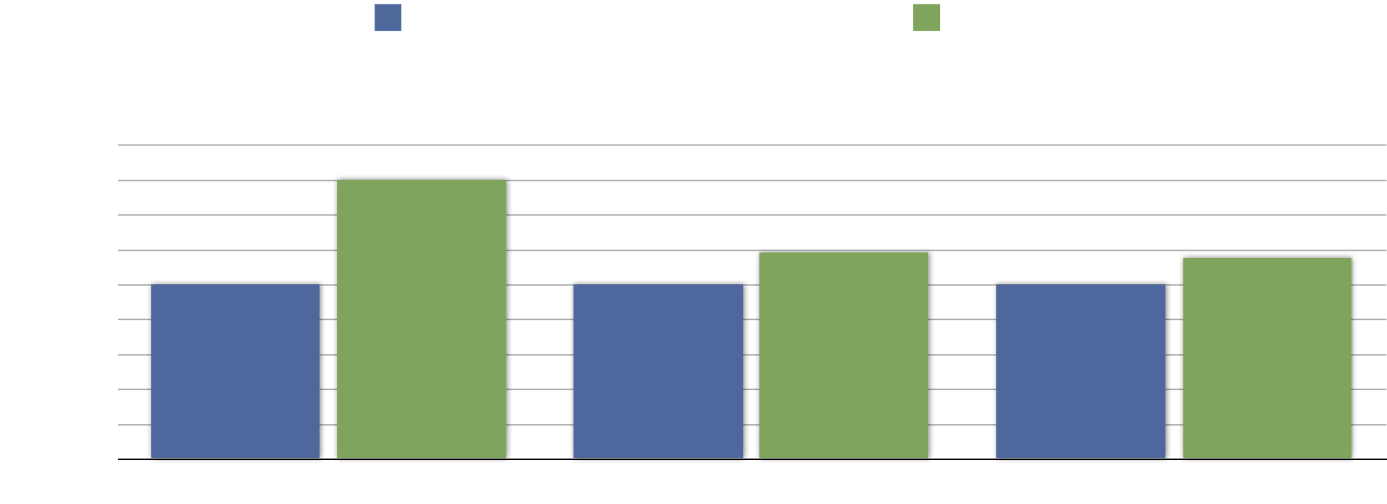
Perceived Cost
Cockburn, Alistair and Laurie Williams. “The Costs and Benefits of Pair Programming” This is Humans and Technology Technical Report 2000.01 (2000): p3

Slide 19
Personality Differences
Some developers will never get along.
Developers have difference hygiene standards.
Developers are opinionated.
Developers are smart.

Slide 20
Skill Differences
Skill mismatches.
Experiences mismatches.
Age mismatches.

Slide 21
Personal Space
You are shoulder-to-shoulder 8 hours / day.
Your computer is not your own.
Your workspace is shared.
Your keyboard and mouse are shared.

Slide 22
What Makes A Good Pair?
Introduction to Pair Programming

Slide 23
Skills
Overlapping but not identical skill set.
Experienced in different areas.
Differing expertise.
Differing points-of-view.

Slide 24
Communication
Communication is the cornerstone of pair programming.
Must be able to listen.
Must be able to articulate.
Must be able to debate without judgement or offense.

Slide 25
Flexibility
Open to new ideas.
Willing to allow their pair to explore.
Ability to adapt to different personalities.
Strong opinions, loosely held.

Slide 26
Is It Right For You?
Introduction to Pair Programming

Slide 27
Time To Market
Cockburn, Alistair and Laurie Williams. “The Costs and Benefits of Pair Programming” This is Humans and Technology Technical Report 2000.01 (2000): p3

Slide 28
Time To Market
50,000 lines of code.
Individual 50 lines/hour = 1000 hours.
Pair at 15% longer = 1150 hours.
TDD at 50% longer = 1500 hours.

Slide 29
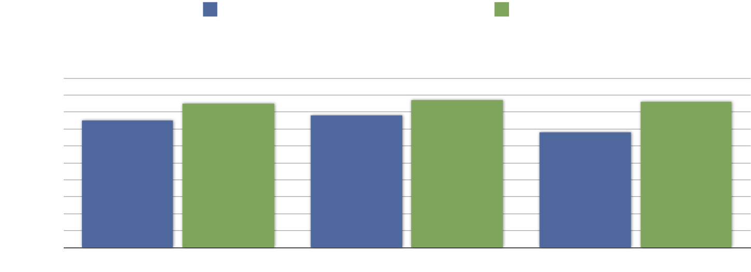
Cost of Defects
IBM reported spending about $250 million repairing and reinstalling fixes to 30,000 customer-reported problems . That is over $8,000 for each defect. A 15% reduction is a savings of $37million.
Cockburn, Alistair and Laurie Williams. “The Costs and Benefits of Pair Programming” This is Humans and Technology Technical Report 2000.01 (2000): p3

Slide 30
Cost of Defects
50,000 lines of code.
Individual 30 defects/1000 lines = 1,500 defects.
Pair at 15% fewer = 1,275 defects.

Slide 31
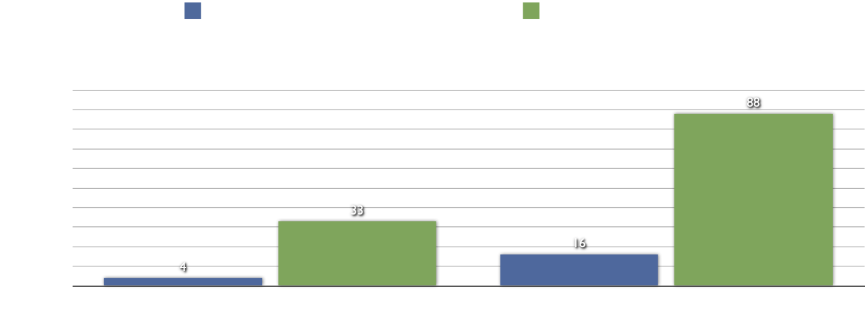
Cost of Defects
Humphrey, W.S., A Discipline for Software Engineering. SEI Series in Software Engineering, ed. P. Freeman, Musa, John. 1995: Addison Wesley Longman, Inc.

Slide 32
Cost of Defects
10 hours / defect internally caught
  1,500 defects = 15,000 hours.
  1,275 defects = 12,750 hours.
40 hours / defect externally discovered
  1,500 defects = 60,000 hours.
  1,275 defects = 51,000 hours.
  150 defects (TDD) = 6,000 hours*
*Nagappan, Nachiappan and E. Michael Maximilien, Thirumalesh Bhat, Laurie Williams. “Realizing quality improvement through test
driven development: results and experiences of four industrial teams” Empir Software Eng (2008): p9

Slide 33
Team Composition
Do your developers get along?
Do you have any hermits?
Do you have a team room?

Slide 34
Truck Number
Do you have area experts in your code?
Do you have areas nobody wants to touch?
Do you have subject matter experts?
Do you have technology experts?

Slide 35
Try It!
  Introduction to Pair Programming

Slide 36
Resources
The Costs and Benefits of Pair Programming
Alistair Cockbutn and Laurie Williams
Pair Programming: What’s in it for Me?
Andrew Begel and Nachiappan Nagappan
All I Really Need to Know about Pair Programming I Learned In Kindergarten
Laurie Williams and Robert Kessler
Realizing Quality Improvement Through Test Driven Developer: Results and Experiences of Four Industrial Teams
Nachiappan Nagappan, E. Michael Maximilien, Thirumalesh Bhat, and Laurie Williams

Slide 37

Q&A

Slide 38

Enjoy
TechGate Conference 2011!

